Slide 1
PLANT DISEASE DETECTION
Presented By:
Akshara T K
TKM23MCA-2009
Guided By:
Dr. Nadera Beevi S

Slide 2
INTRODUCTION
Plant diseases cause significant crop losses, and traditional identification methods are slow and require expert knowledge.
This project develops an automated plant disease detection system using deep learning models CNN, AlexNet, ResNet.
Models are trained on the diverse PlantVillage dataset to ensure accurate disease identification.
The goal is to provide farmers with a fast, reliable solution, improving crop management and food security.

Slide 3
PROBLEM STATEMENT
Traditional plant disease identification methods are time-consuming, labor-intensive, and inaccessible to many farmers, especially in rural areas.
This project aims to develop an automated system using deep learning models: CNN, AlexNet, and ResNet.
The system will provide accurate and scalable detection of plant diseases.
The solution enables timely interventions, leading to improved crop management and productivity.

Slide 4
LITERATURE REVIEW
TITLE | AUTHORS | PUBLISHED YEAR | PUBLISHER | ALGORITHM USED
Towards Generalization of Deep Learning- based plant disease identification under controlled and Field conditions | Aanis Ahmed Aly L Gamal Dharmendra Saraswat | 2023 | IEEE | Inception V3 ResNet50 VGG16 DenseNet169 Xception
A comprehensive review on detection of plant disease using machine learning and deep learning approaches | C Jackulin S. Murugavalli | 2022 | Elsevier | Naïve Bayes Decision Tree CNN Inception – V4

Slide 5
Plan To Solve the Problem
Develop an automated plant disease detection system using CNN, AlexNet, and ResNet. The goal is to compare model accuracies and identify the best-performing architecture.
APPROACH:
Preprocess the PlantVillage dataset by cleaning and augmenting images.
Implement and train CNN, AlexNet, and ResNet models, then compare their performance.
Evaluate model accuracy and select the best-performing architecture.

Slide 6
Proposed System
Accurate Detection: Uses CNN, AlexNet, and ResNet50 models for precise plant disease identification.
Advanced Feature Extraction: Leverages transfer learning for improved feature extraction from plant leaf images.
User-Friendly Interface: Built with Flask for easy uploading and real-time disease predictions.

Slide 7
Dataset and Data Preprocessing
PlantVillage Dataset:
The Plant Village dataset is a collection of plant images used for disease detection. It includes pictures of healthy and diseased leaves across various plant species, helping train models to identify plant health issues
Data Preprocessing:
Techniques such as cropping, rotation, and flipping will be applied to the images to increase the size and diversity of the training data.
Images will be resized, normalized and converted to grayscale to optimize the input for the model.

Slide 8
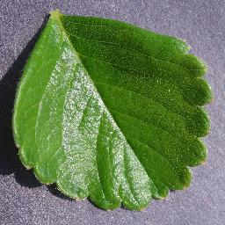
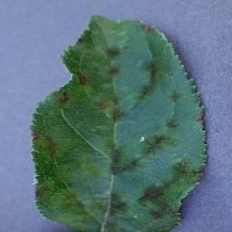
Dataset
Healthy
Apple Scab

Slide 9
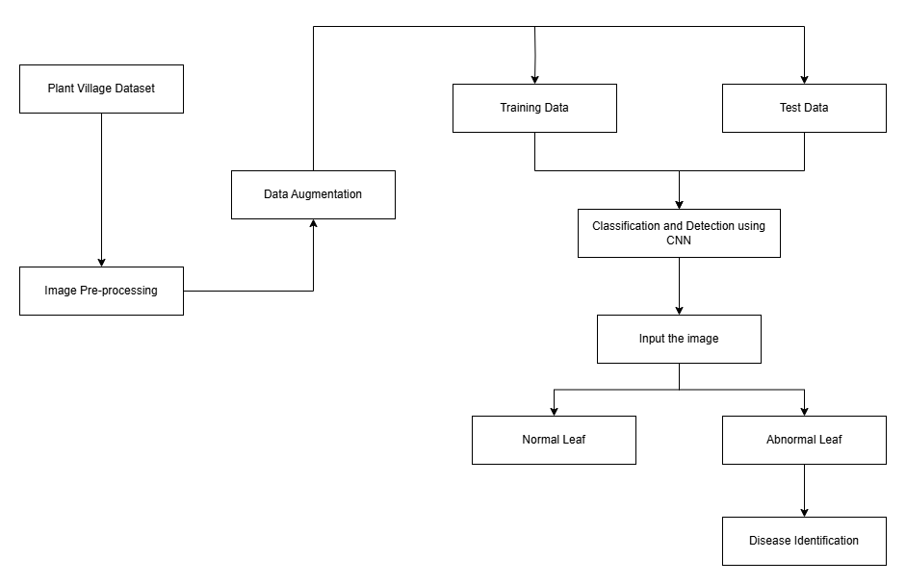
Block Diagram

Slide 10
Results
 | CNN | AlexNet | ResNet50
Validation Accuracy | 93.14% | 89.32% | 70.13%
Training Accuracy | 93.75% | 93.75% | 63.02%

Slide 11
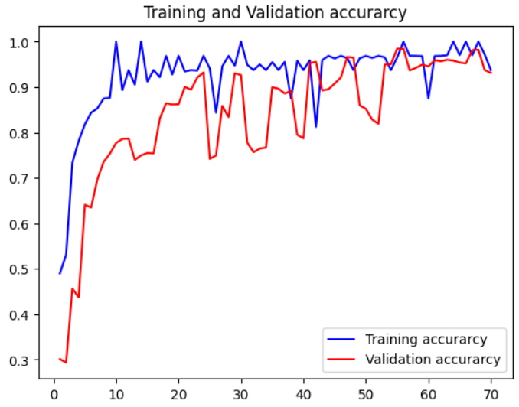
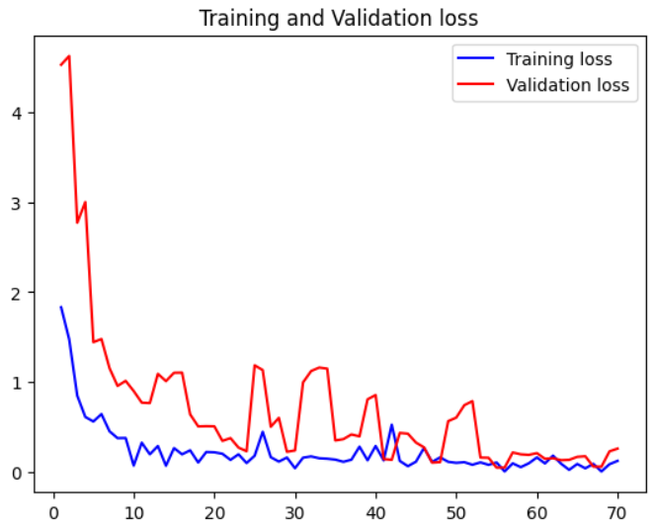
Evaluation Curves - CNN

Slide 12
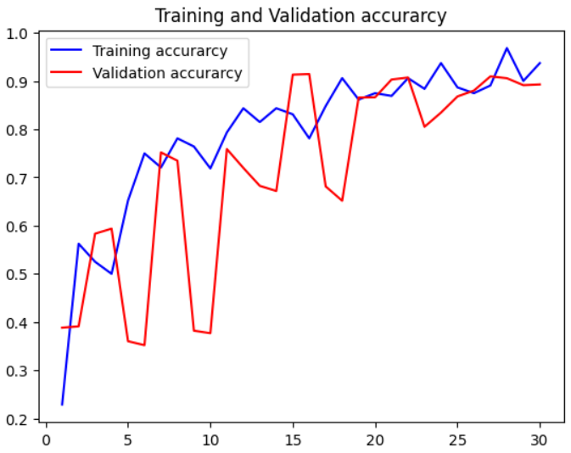
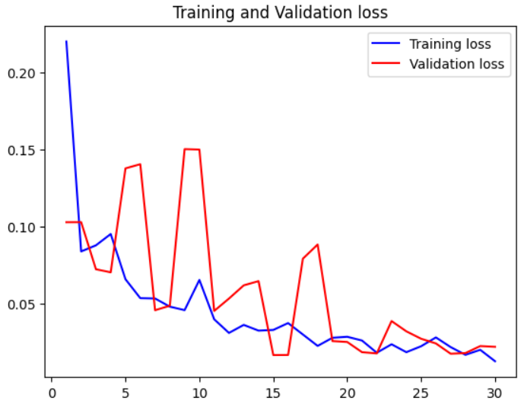
Evaluation Curves - AlexNet

Slide 13
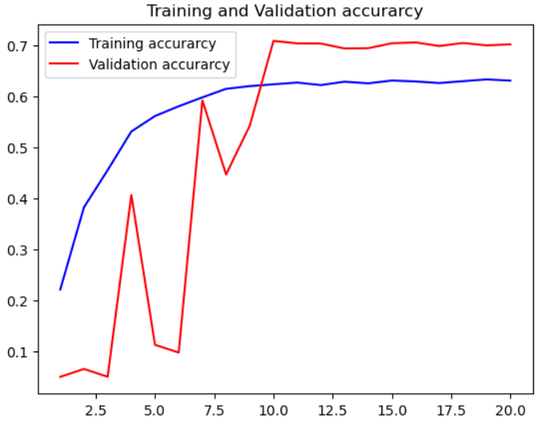
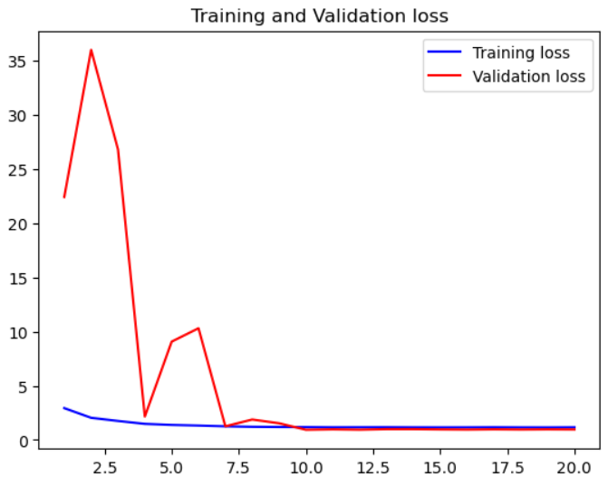
Evaluation Curves - ResNet50

Slide 14
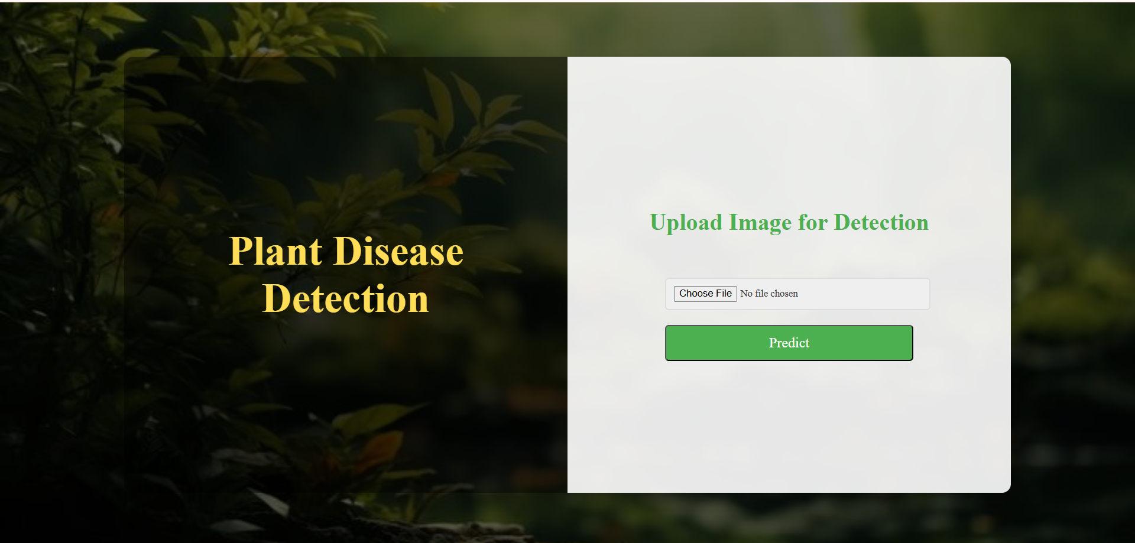
Screenshots

Slide 15
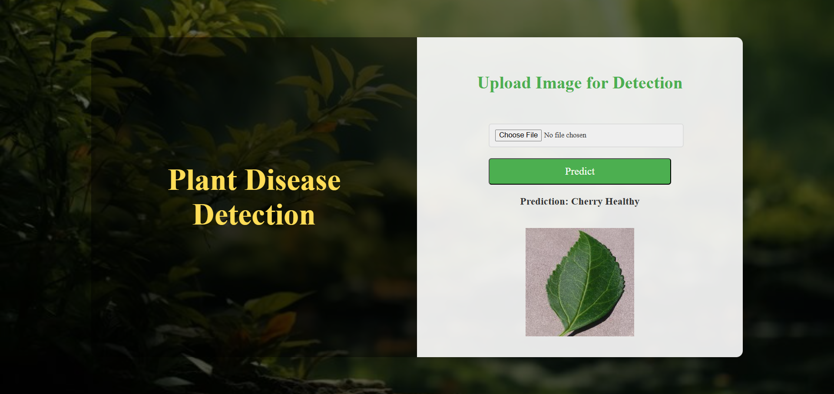

Slide 16
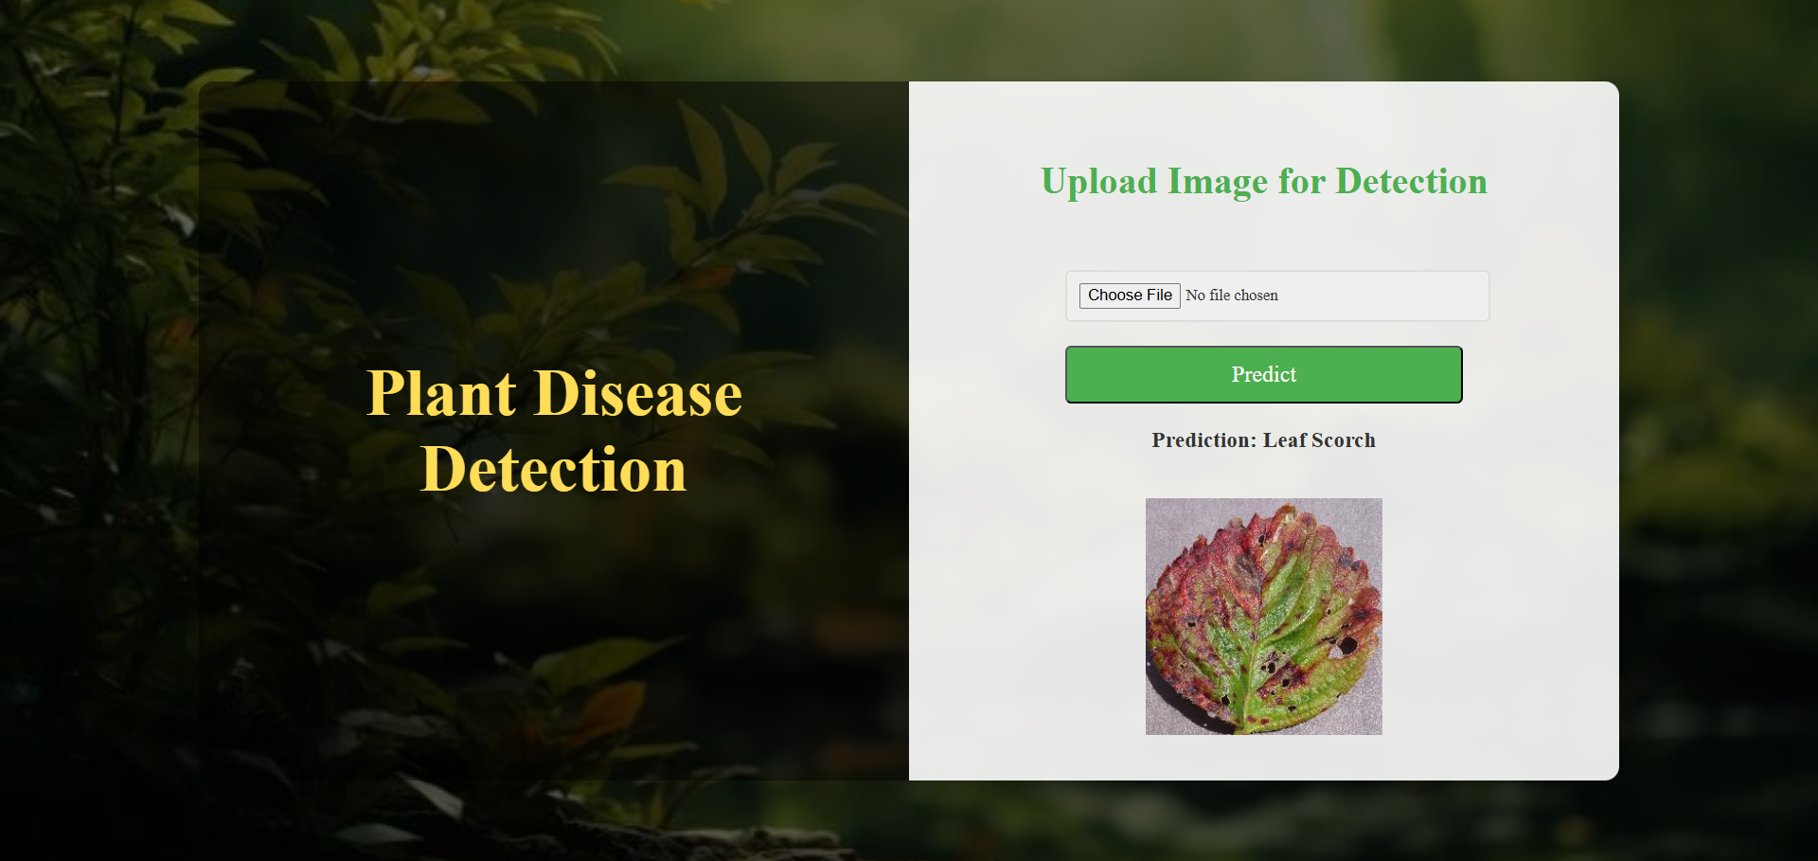

Slide 17
Future Scope
Mobile and IoT integration: Develop a mobile app or deploy the model on IoT devices (e.g., Raspberry Pi) for real-time, offline plant disease detection in the field.
Multi-Disease and Early Detection: Extend the model to detect multiple diseases in a single leaf image and identify early-stage symptoms for proactive intervention.
Disease localization and Severity Estimation: Implement image segmentation to highlight infected areas on leaves and predict the percentage of disease-affected regions, aiding in precise severity estimation and treatment recommendations.

Slide 18
Thank you!

